Slide 1
Beam model study
Isabella Sofia

Slide 2
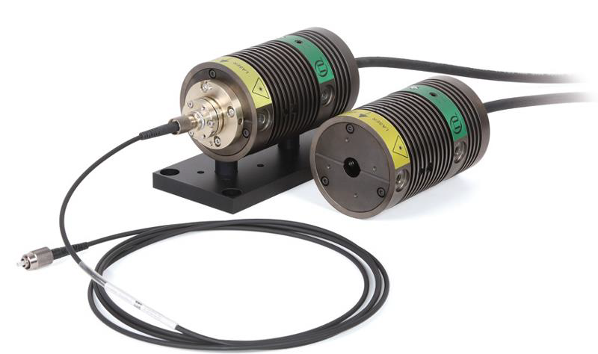
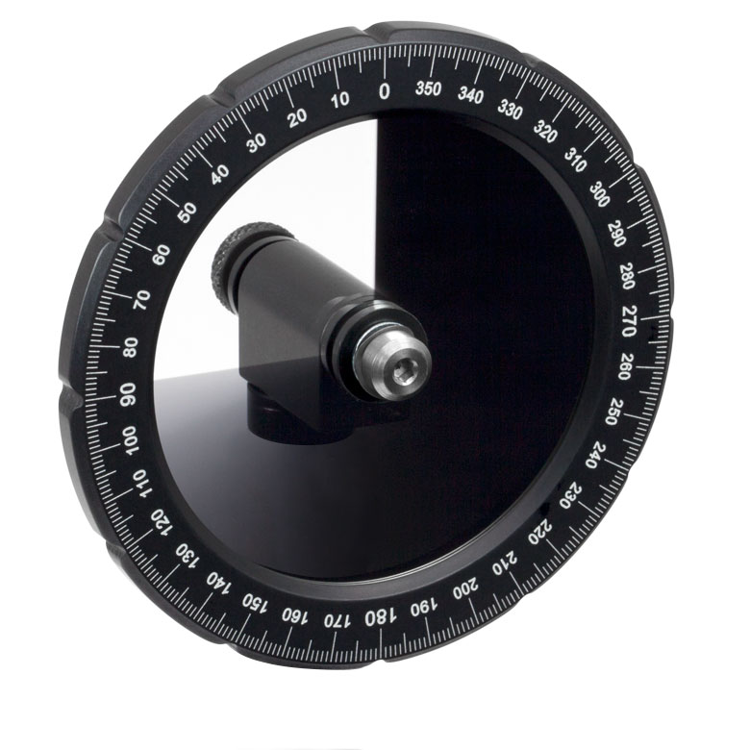
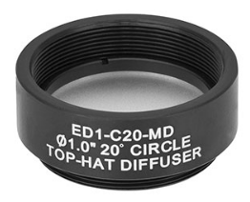
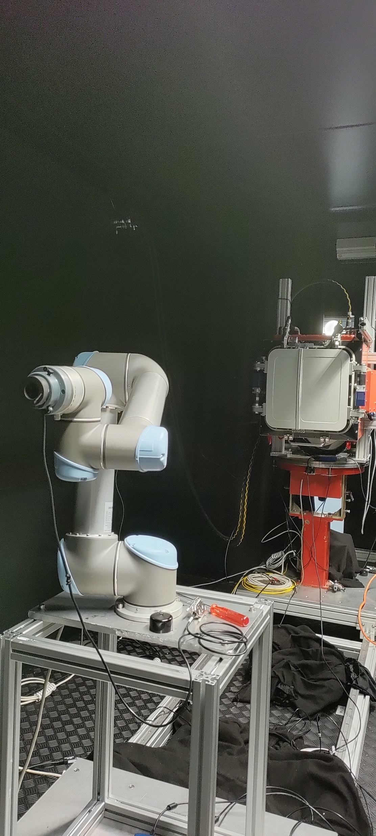
Laser beam – set-up
Experimental set-up
Robot arm 2D scans of radius 0.3 m
Scan over the (x,y) plane
Data consists in one power value for each (x,y) point in the circle of radius 0.3 m
Laser «center» ideally on (0,0)
Use of two diffusers (20 + 5 °)
Robot Arm (Universal Robots UR5)

Slide 3
Starting point – our goals
Goals
How?
As far as it concerns the darkbox (Verification and Validation facility), we would like to
know how uniform is our beam (requirement of 2%)
make sure that its center is reasonably located at (0,0)
be able to know how many photons we can expect at a certain distance from the source with certain experimental conditions
This means:
Knowing the beam as best as we can
But also: a lot of additional and interesting questions…
does the diffused beam reflect the physics underneath it? (e.g. how do the diffusers work?)
Which functional shape does the beam have?
Are we able to describe the beam with a «model»?
Can we describe both the laser and the NSB (LED) beams in some way?
Through several fits on experimental data
Fit on the one-dimensional distribution of power along the x and y axis (i.e. y = 0 and x = 0 respectively, because we are interested in the center)
This can help us to initialize the 2D model
Fit on the two-dimensional distribution of power to have a «beam model»

Slide 4
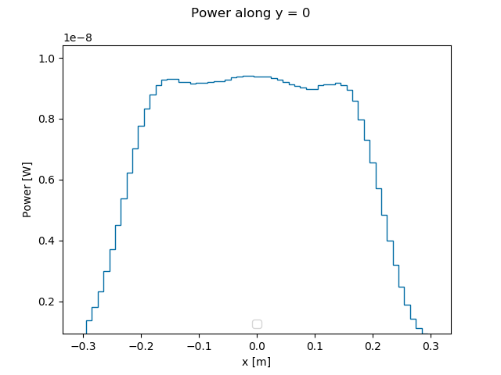
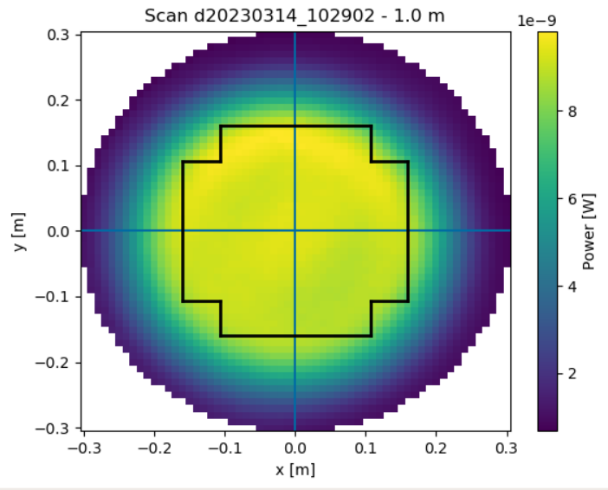
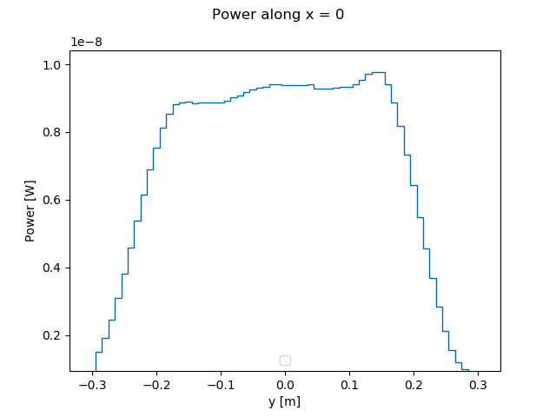
Starting point – our data
Slicing along y = 0
Slicing along x = 0
File: d20230314_102902_2dscan.csv
Source: laser
Distance: 1 m

Slide 5
Starting point - ideas
What we know
The laser beam should be gaussian
The diffusers apply a circular tophat function
The result should be a uniform beam that somehow reflects this characteristics: a gaussian beam «flattened» by a tophat function
Starting idea
Could the beam be described by a function that is the simple convolution of a gaussian and a tophat function?
Let’s see if that’s the case
NB: the beam could also be «tilted» w.r.t. the (x,y) scan-plane, so we could tilt the gaussian function by an angle θ

Slide 6
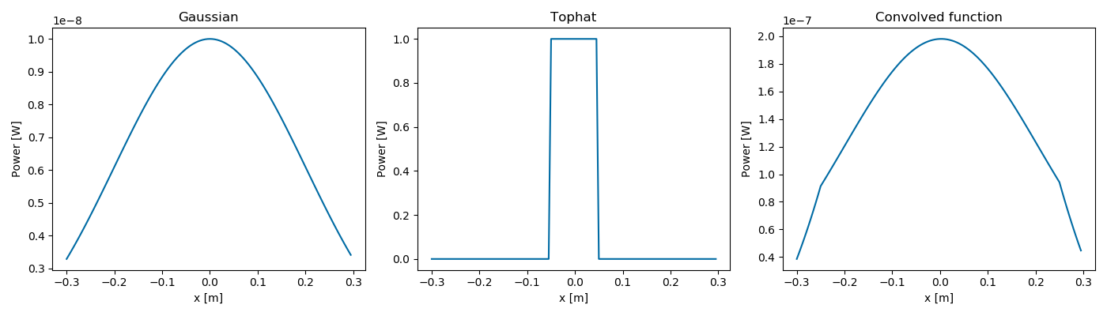
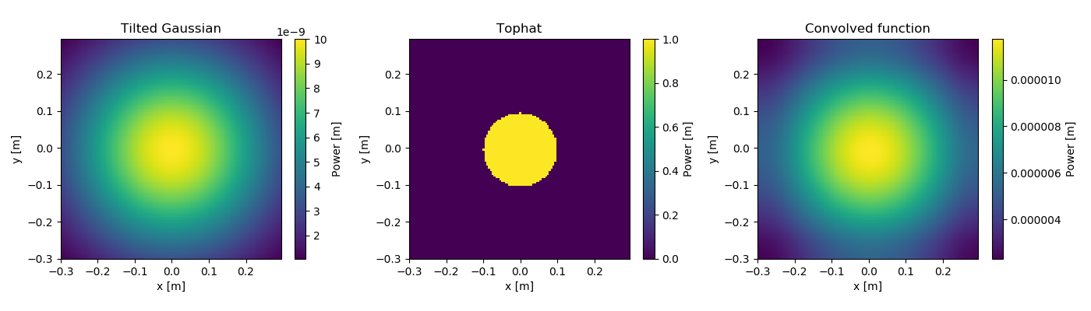
Starting idea - «simple» convolution: example
1D
2D

Slide 7
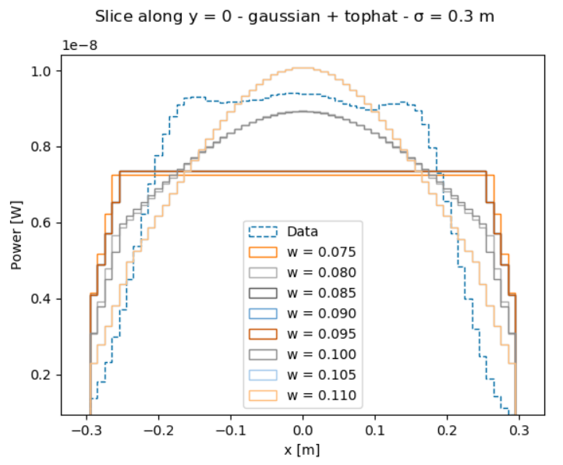
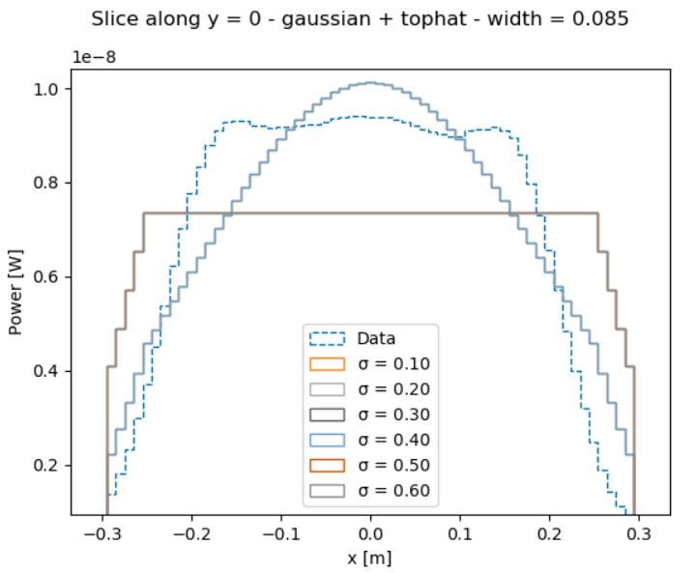
Starting idea - «simple» convolution: first 1D fit
We see that our data is flatter than our convoluted function
Initializing the fit parameters is not trivial, fit is very subject to little variations on initialized parameters
It could become prohibitive for a 2D fit
We have to dig a bit deeper into our options…

Slide 8
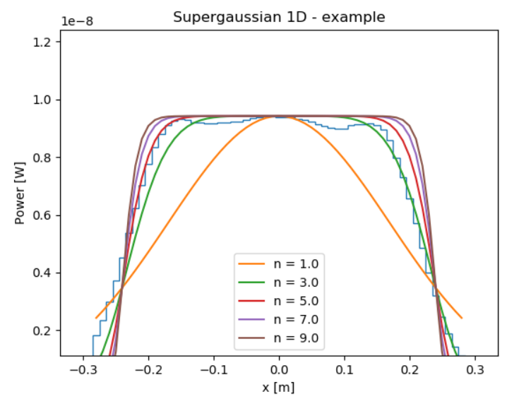
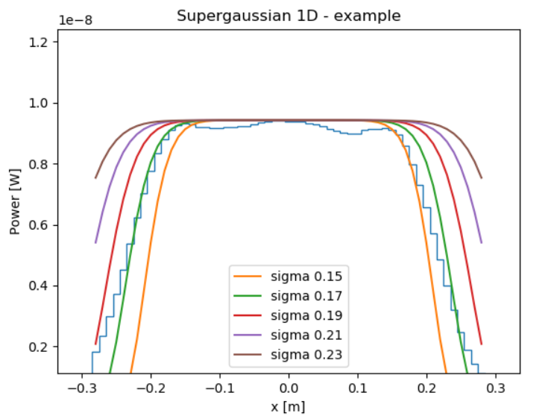
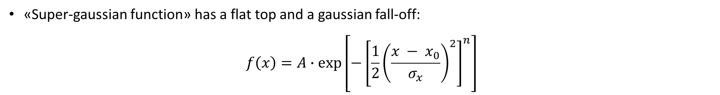
An alternative: supergaussian distribution
«Super-gaussian function» has a flat top and a gaussian fall-off:
$$f\left(x\right)=A∙exp⁡\left[−{\left[{\frac{1}{2}\left(\frac{x − x_{0}}{σ_{x}}\right)}^{2}\right]}^{n}\right]$$
Varying «n»
Varying «σ» (n = 5)
Data: slice along y = 0
rp-photonics

Slide 9
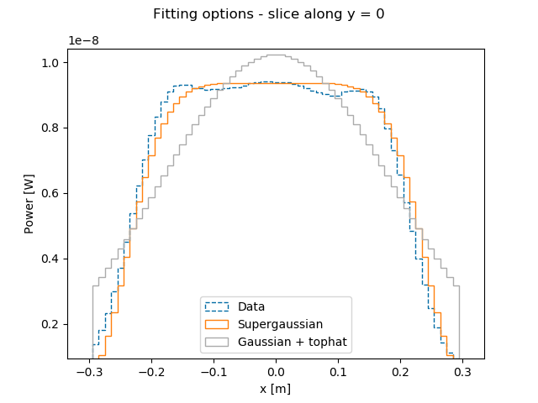
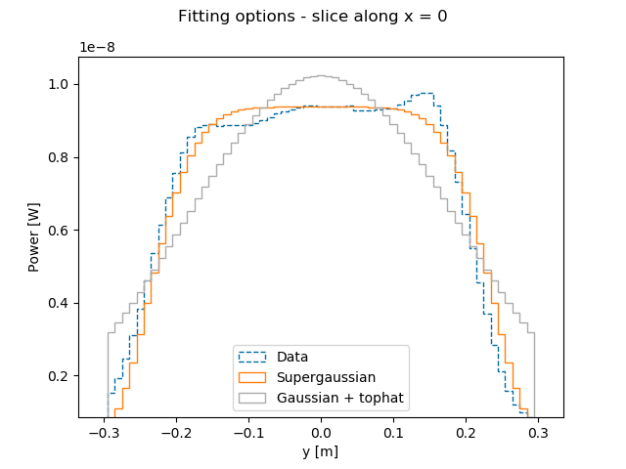
Comparison
Indeed, a supergaussian description can allow us to continue the procedure, i.e. try to fit the 2D map with the bidimensional function

Slide 10
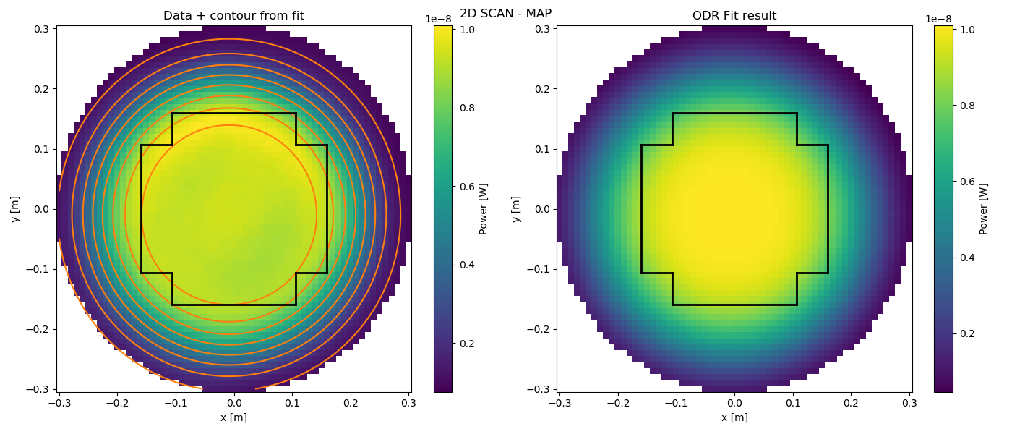
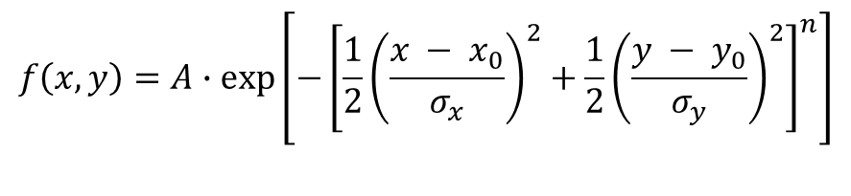
2D data
$$f\left(x, y\right)=A∙exp⁡\left[−{\left[{\frac{1}{2}\left(\frac{x − x_{0}}{σ_{x}}\right)}^{2}+{\frac{1}{2}\left(\frac{y − y_{0}}{σ_{y}}\right)}^{2}\right]}^{n}\right]$$

Slide 11
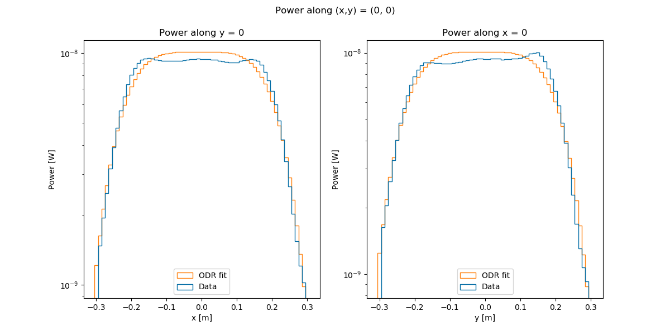
Other fit results (1)
Histograms obtained from the 2D fit parameters by creating one evenly spaced array for x (y) between (- scan_size, + scan_size) and one array full of zeros for y (x) and evaluating the fitted 2D function on these coordinates, i.e. f(0., y) and f(x, 0.)

Slide 12
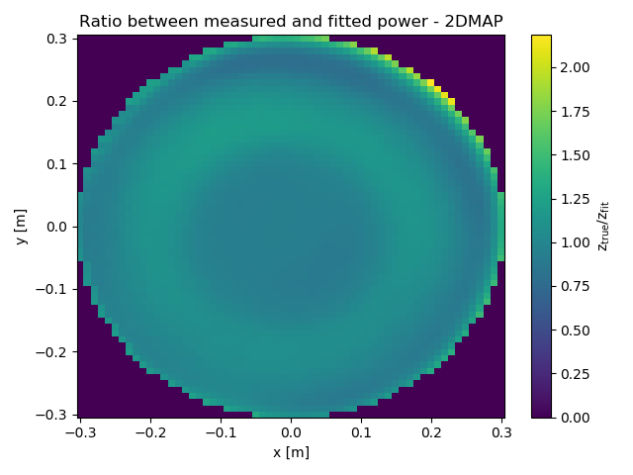
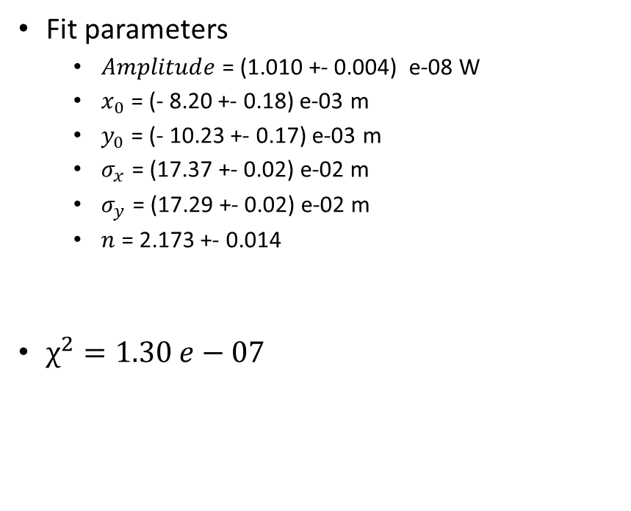
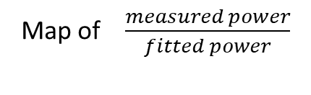
Other fit results (2)
Fit parameters
$Amplitude$= (1.010 +- 0.004) e-08 W
$x_{0}$ = (- 8.20 +- 0.18) e-03 m
$y_{0}$ = (- 10.23 +- 0.17) e-03 m
$σ_{x}$ = (17.37 +- 0.02) e-02 m
$σ_{y}$ = (17.29 +- 0.02) e-02 m
$n$ = 2.173 +- 0.014
$χ^{2}=1.30 e−07$
Map of $\frac{measured power}{fitted power}$

Slide 13
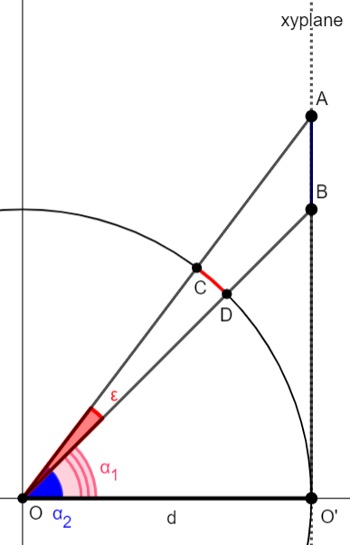
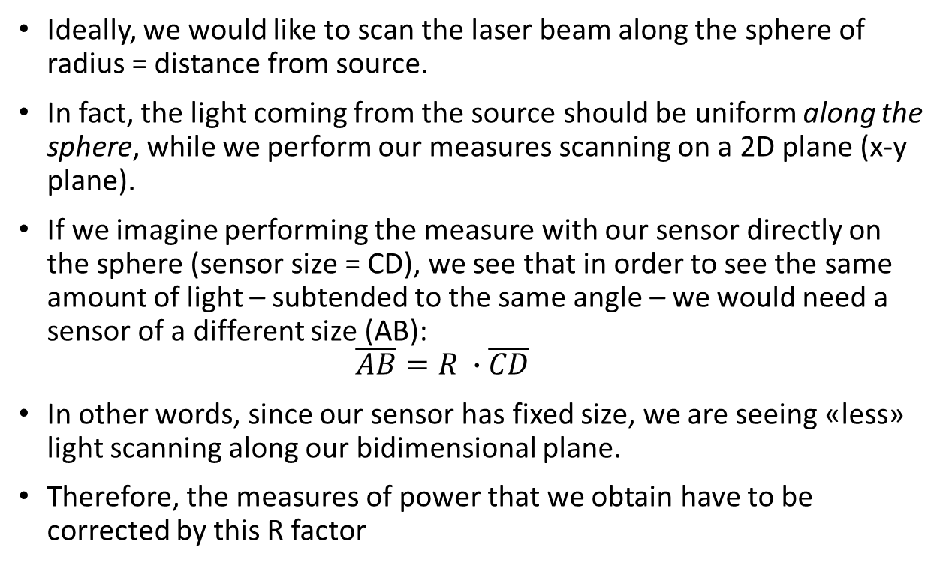
Additional considerations: correction on power values (1)
Ideally, we would like to scan the laser beam along the sphere of radius = distance from source.
In fact, the light coming from the source should be uniform along the sphere, while we perform our measures scanning on a 2D plane (x-y plane).
If we imagine performing the measure with our sensor directly on the sphere (sensor size = CD), we see that in order to see the same amount of light – subtended to the same angle – we would need a sensor of a different size (AB):
$$\overline{AB}=R ∙\overline{CD}$$
In other words, since our sensor has fixed size, we are seeing «less» light scanning along our bidimensional plane.
Therefore, the measures of power that we obtain have to be corrected by this R factor

Slide 14
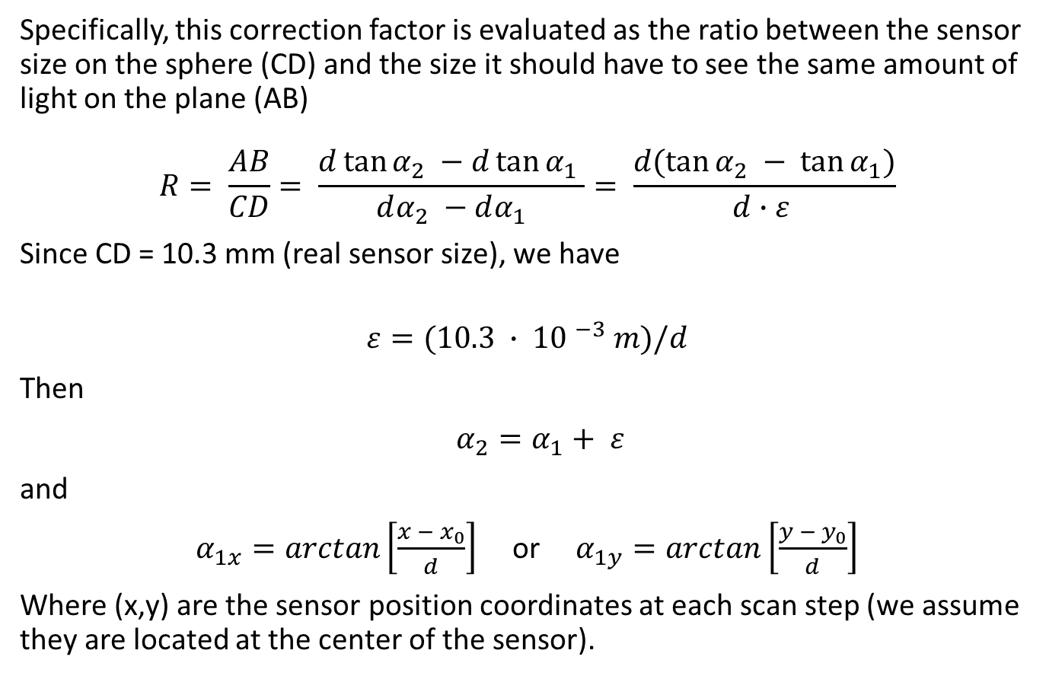
Additional considerations: correction on power values (2)
Specifically, this correction factor is evaluated as the ratio between the sensor size on the sphere (CD) and the size it should have to see the same amount of light on the plane (AB)
$$R= \frac{AB}{CD}= \frac{d\tan{α_{2} −d\tan{α_{1}} }}{dα_{2} −dα_{1}}= \frac{d(\tan{α_{2} − \tan{α_{1})}}}{d∙ε }$$
Since CD = 10.3 mm (real sensor size), we have
$$ε=(10.3 ∙ {10 }^{−3} m)/d$$
Then
$α_{2}=α_{1}+ ε$
and
$α_{1x}=arctan\left[\frac{x − x_{0}}{d}\right]$ or $α_{1y}=arctan\left[\frac{y − y_{0}}{d}\right]$
Where (x,y) are the sensor position coordinates at each scan step (we assume they are located at the center of the sensor).

Slide 15
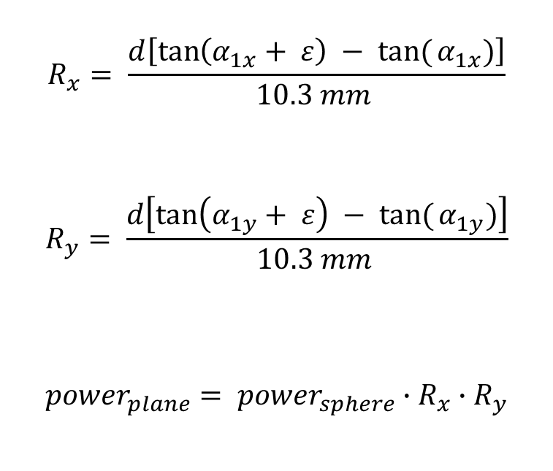
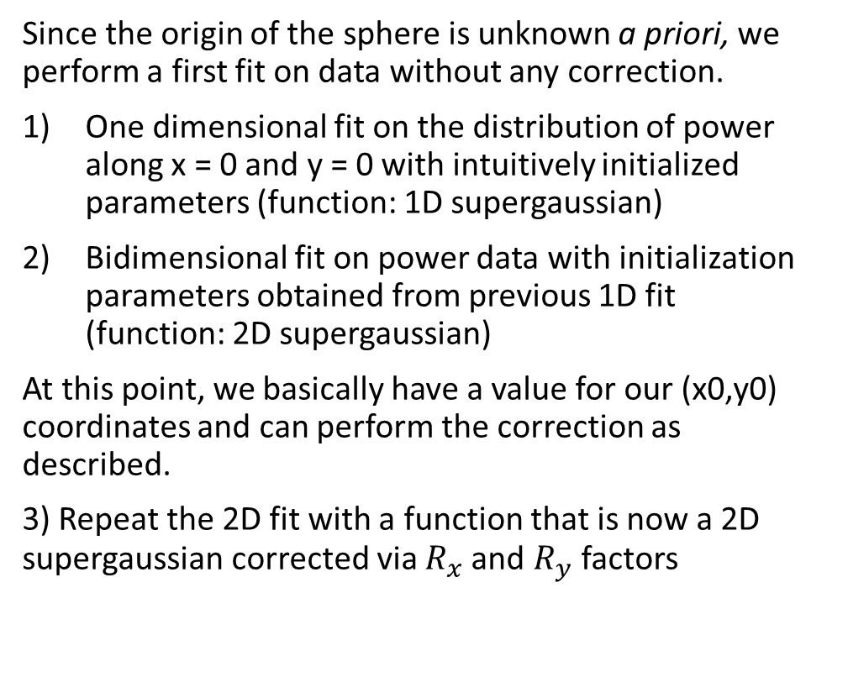
Additional considerations: correction on power values (3)
Since the origin of the sphere is unknown a priori, we perform a first fit on data without any correction.
One dimensional fit on the distribution of power along x = 0 and y = 0 with intuitively initialized parameters (function: 1D supergaussian)
Bidimensional fit on power data with initialization parameters obtained from previous 1D fit (function: 2D supergaussian)
At this point, we basically have a value for our (x0,y0) coordinates and can perform the correction as described.
3) Repeat the 2D fit with a function that is now a 2D supergaussian corrected via $R_{x}$and $R_{y}$factors
$$R_{x}= \frac{d\left[\tan\left(α_{1x}+ ε\right) − tan({α_{1x})}\right]}{10.3 mm }$$
$$R_{y}= \frac{d\left[\tan\left(α_{1y}+ ε\right) − tan({α_{1y})}\right]}{10.3 mm }$$
${power}_{plane}= {power}_{sphere}∙R_{x}$ $∙R_{y}$

Slide 16
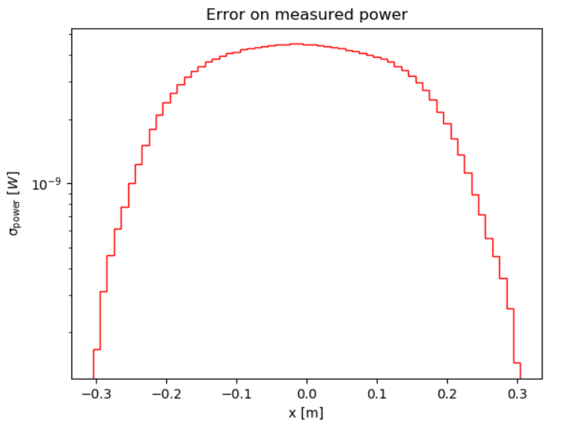
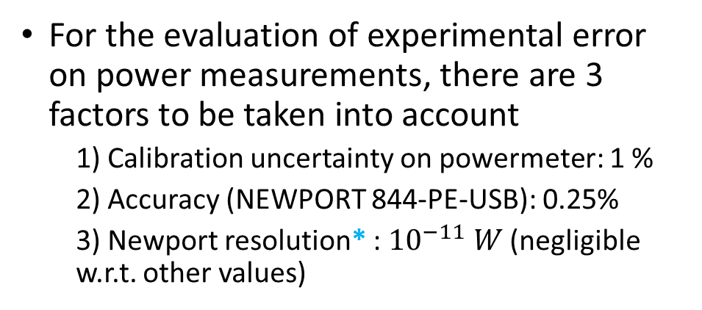
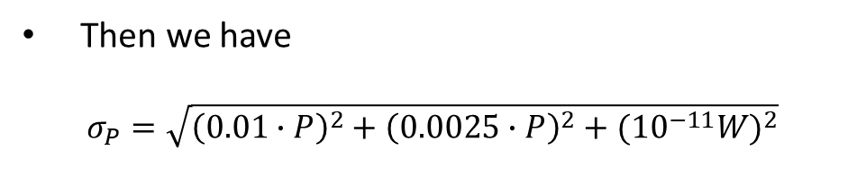
Additional considerations: error on power values
For the evaluation of experimental error on power measurements, there are 3 factors to be taken into account
1) Calibration uncertainty on powermeter: 1 %
2) Accuracy (NEWPORT 844-PE-USB): 0.25%
3) Newport resolution* : ${10}^{−11} W$ (negligible w.r.t. other values)
(semi-log scale)
Then we have
$$σ_{P}=\sqrt{{\left(0.01∙P\right)}^{2}+{\left(0.0025∙P\right)}^{2}+({{10}^{−11}W)}^{2}}$$
* Evaluated from data of a filter wheel scan at a rate of 600 Hz, evaluating the maximum power difference measured for each FW step and finding the minimum difference among these values
negligible

Slide 17
Laser beam - conclusions
«Supergaussian» description works fine:
Good fit results
Easier to initialize parameters
Easier to automatize process
We implemented a fit procedure to automatize as far as possible the chain (and applying all the corrections)
1D fit → 2D fit → fit results and plots
Can the same procedure may be applied for NSB model?

Slide 18
NSB beam study

Slide 19
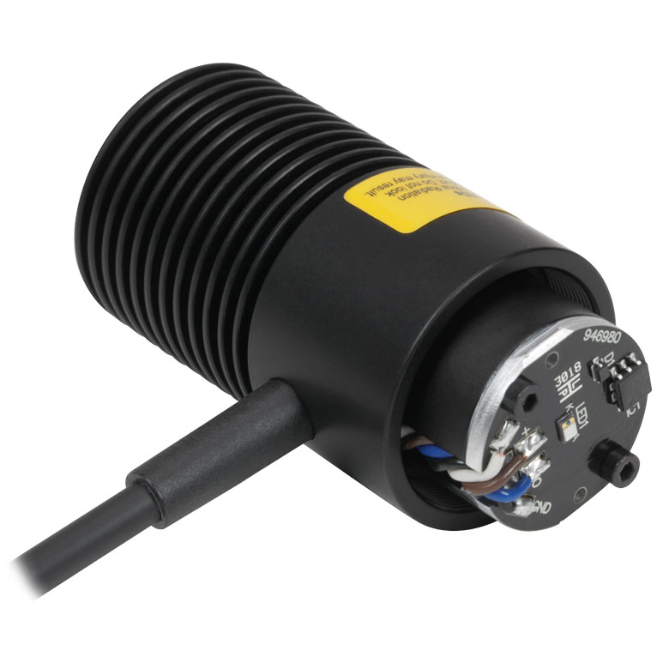
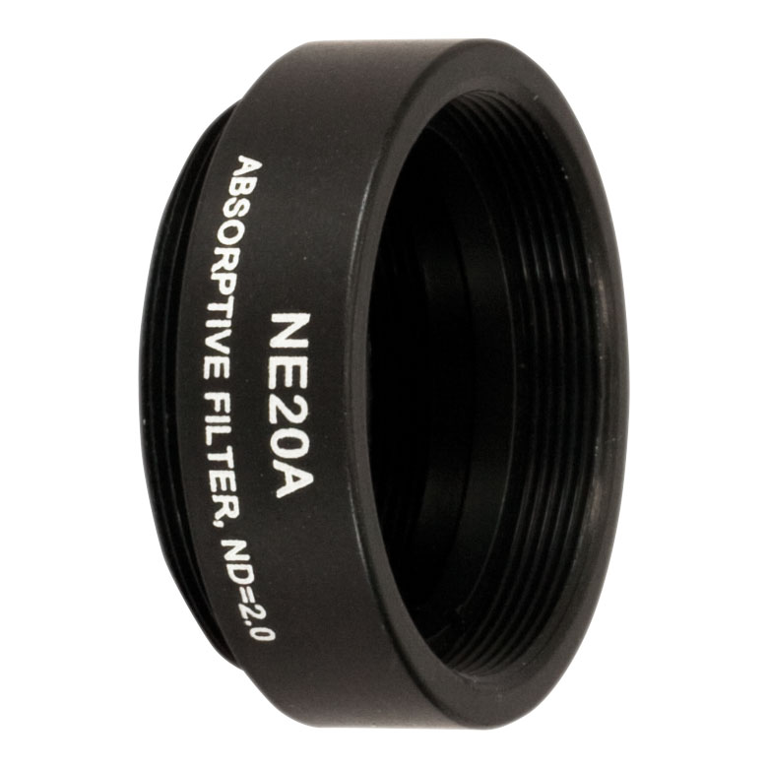
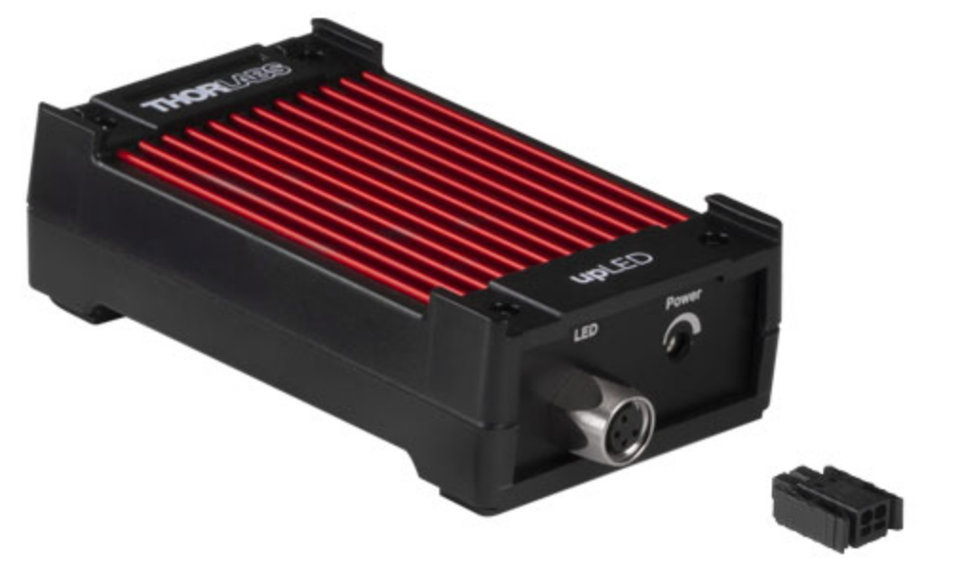
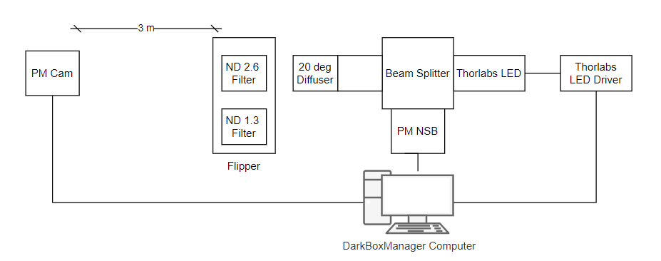
NSB set-up and measures
Pretty similar modus operandi:
Robot arm 2D scans of radius 0.3 m
Scan over the (x,y) plane
Data consists of one power value for each (x,y) point in the circle of radius 0.3 m
Use of one diffuser (20°)
Use of Neutral Density filters (called MAX or MIN filters)
Robot Arm (Universal Robots UR5)

Slide 20
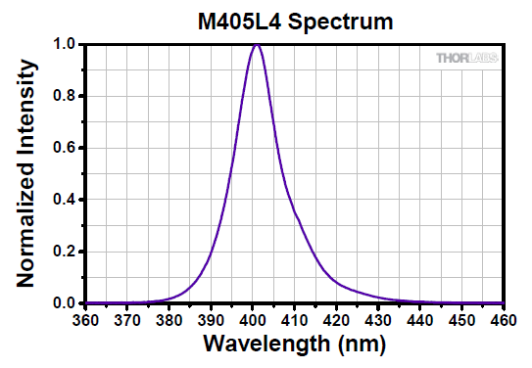
Looking at NSB data (1)
Considerations:
Our LED should deliver nearly monochromatic light, with a peaked spectrum (peak-wavelenght λ = 405 nm): can we assume it as almost gaussian?
We use the same kind of circle tophat diffuser used for laser beam → final result should be the same: a peaked function «flattened» by a tophat
Data taken with same set-up
same correction ✔
same evaluation of error on measured power? Not obvious, because our PM measures always with a wavelength set to 400 nm, not 405 nm → this can lead to multiple considerations and observations…
(Spectrum from Thorlabs LED specs pdf)

Slide 21
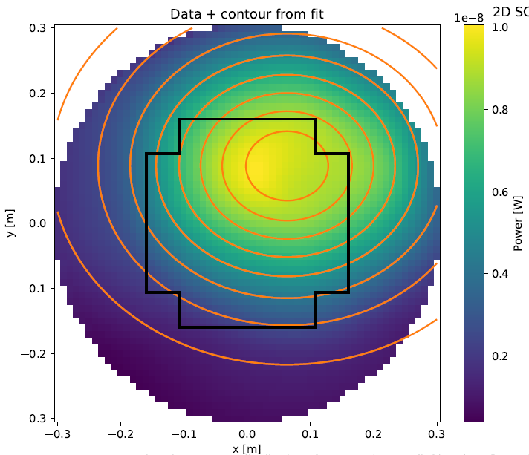
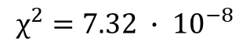
Looking at NSB data (2)
Meanwhile, we can:
Try re-using the supergaussian, expecting a different order n: ✔
Initial parameters should also be slightly different, e.g. (x0, y0) are no longer expected to be (0,0): ✔
MIN and MAX filter cases should be the same, except for the amplitude value: ✔
Indeed, the code seems to be working ✔
We can obtain the «actual» position of our LED:
x0 = 0.0630 +- 0.0005 m
y0 = 0.0881 +- 0.0004 m
$$χ^{2}=7.32 ∙ {10}^{−8}$$

Slide 22
Considerations on NSB values
Starting point:
we have a UV LED that should deliver monochromatic light at λ = 405 nm
The specs provided by the manufacturer tell us that the emission has a «typical» peak wavelength at λ = 405 nm, with a minimum at 397 nm and a maximum at 413 nm (see distribution on previous slides):
Moreover, our powermeter is always set to measure light with a λ = 400 nm
So how does all this translate into our measures and their «reliability»?
This leads us to a more general question: how does our capability to detect light vary with the variation of light’s wavelength? How does this influence our measures?

Slide 23
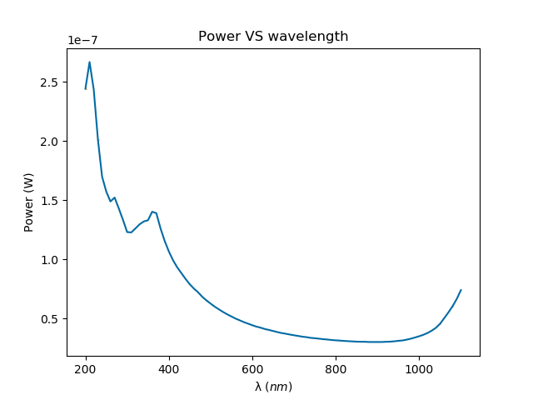
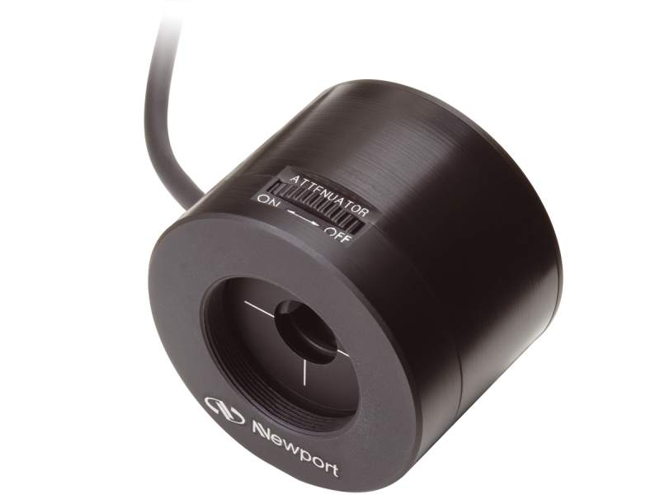
Considerations on NSB values – «wavelength scan»
We cannot vary the LED emission itself…
This means we have to study our powermeters: - Before a measure, we set a value of wavelength on our powermeter - we could see how the measured power varies if we set different wavelengths on our PM, while we supply a constant light
Power measures vary because the powermeter has its own quantum efficiency, which varies with wavelength values
We perform this «wavelength scan» supplying a constant light with the laser (400 nm light) and varying the set wavelength on PM
Experimental settings: FW @ 1000 photons, rate of 1 MHz
Measured power VS wavelength
Powermeter

Slide 24
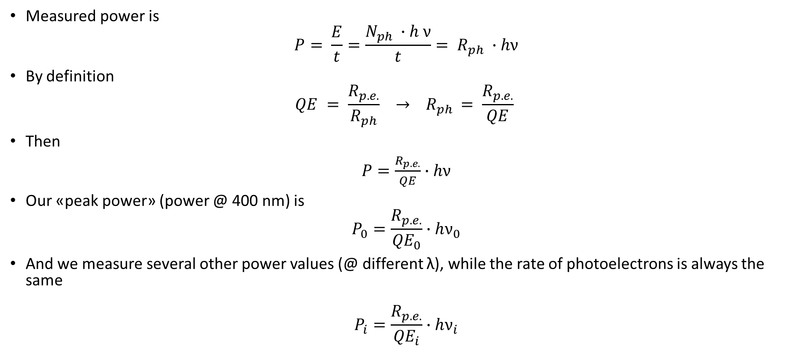
Considerations on NSB values – relative QE
This should allow us to evaluate the relative quantum efficiency of our powermeters
Measured power is
$$P= \frac{E}{t}=\frac{N_{ph} ∙h ν}{t}= R_{ph} ∙hν$$
By definition
$$QE = \frac{R_{p.e.}}{R_{ph}} → R_{ph }= \frac{R_{p.e.}}{QE}$$
Then
$P=\frac{R_{p.e.}}{QE}∙hν$
Our «peak power» (power @ 400 nm) is
$$P_{0}=\frac{R_{p.e.}}{{QE}_{0}}∙hν_{0}$$
And we measure several other power values (@ different λ), while the rate of photoelectrons is always the same
$$P_{i}=\frac{R_{p.e.}}{{QE}_{i}}∙hν_{i}$$

Slide 25
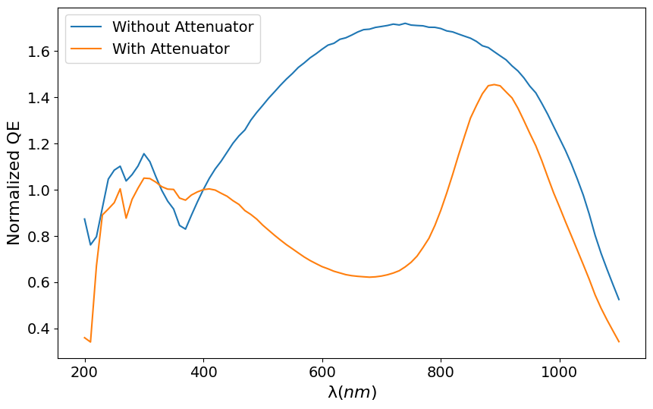
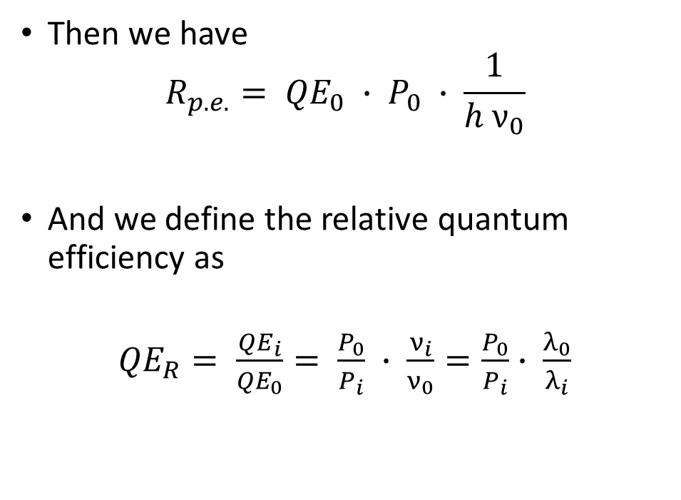
Considerations on NSB values – relative QE
Then we have
$$R_{p.e.}= {QE}_{0} ∙ P_{0} ∙ \frac{1}{h ν_{0}}$$
And we define the relative quantum efficiency as
${QE}_{R}= \frac{{QE}_{i}}{{QE}_{0}}= \frac{P_{0}}{P_{i}} ∙ \frac{ν_{i}}{ν_{0}}=\frac{P_{0}}{P_{i}}∙ \frac{λ_{0}}{λ_{i}}$
Relative quantum efficiency VS wavelength

Slide 26

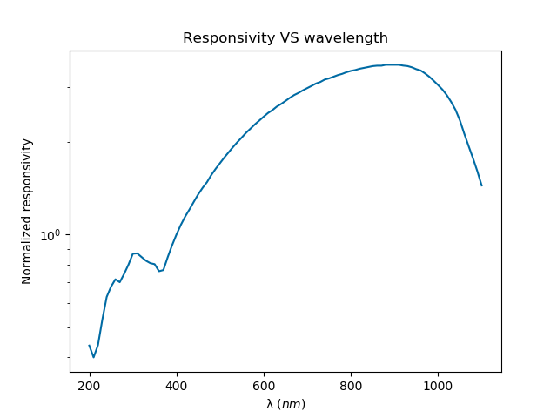
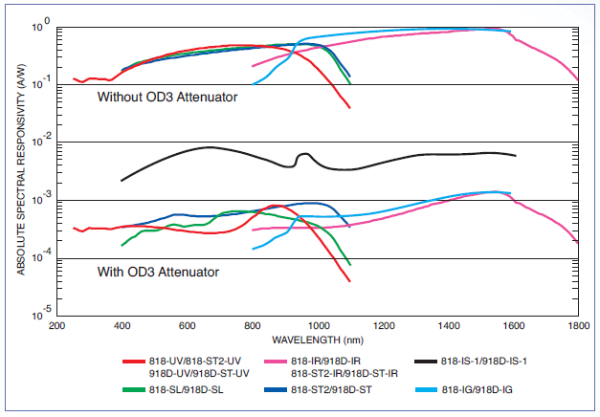
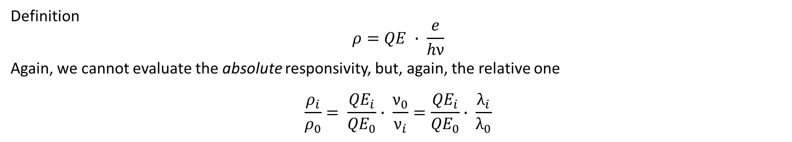
Detector’s responsivity
Definition $$ρ=QE ∙ \frac{e}{hν}$$
Again, we cannot evaluate the absolute responsivity, but, again, the relative one
$$\frac{ρ_{i}}{ρ_{0}}= \frac{{QE}_{i}}{{QE}_{0}}∙ \frac{ν_{0}}{ν_{i}}=\frac{{QE}_{i}}{{QE}_{0}}∙ \frac{λ_{i}}{λ_{0}}$$
Work in progress
1) Our measures (RELATIVE responsivity)
2) Typical ABSOLUTE spectral responsivity of Newport's low power detectors.

Slide 27
Considerations on NSB values: evaluation of «error»
Then, since our LED emission is at 405 nm, but we always measure at 400 nm - we can find the (relative) quantum efficiency corresponding to λ = 405 nm - we see how much this value differs from the peak value (i.e. from 1)
Our uncertainty on NSB power measurements should be at least this value
We obtain an uncertainty of 2.29 %
This values should be taken into account while performing the beam modeling…
Work in progress

